Slide 1
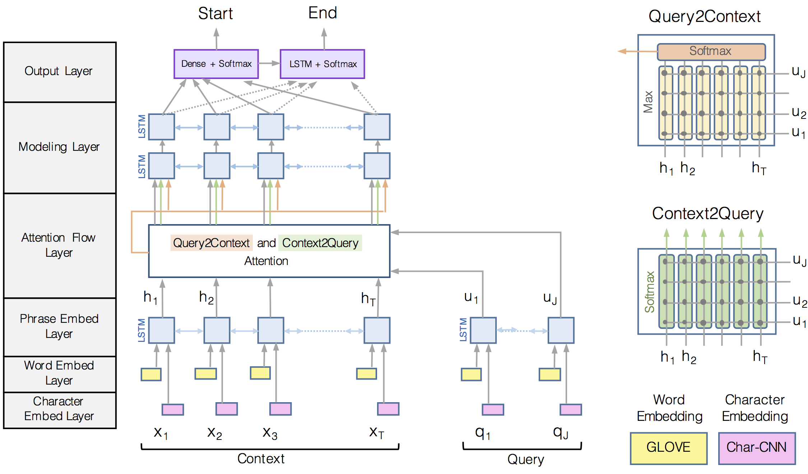

Slide 2
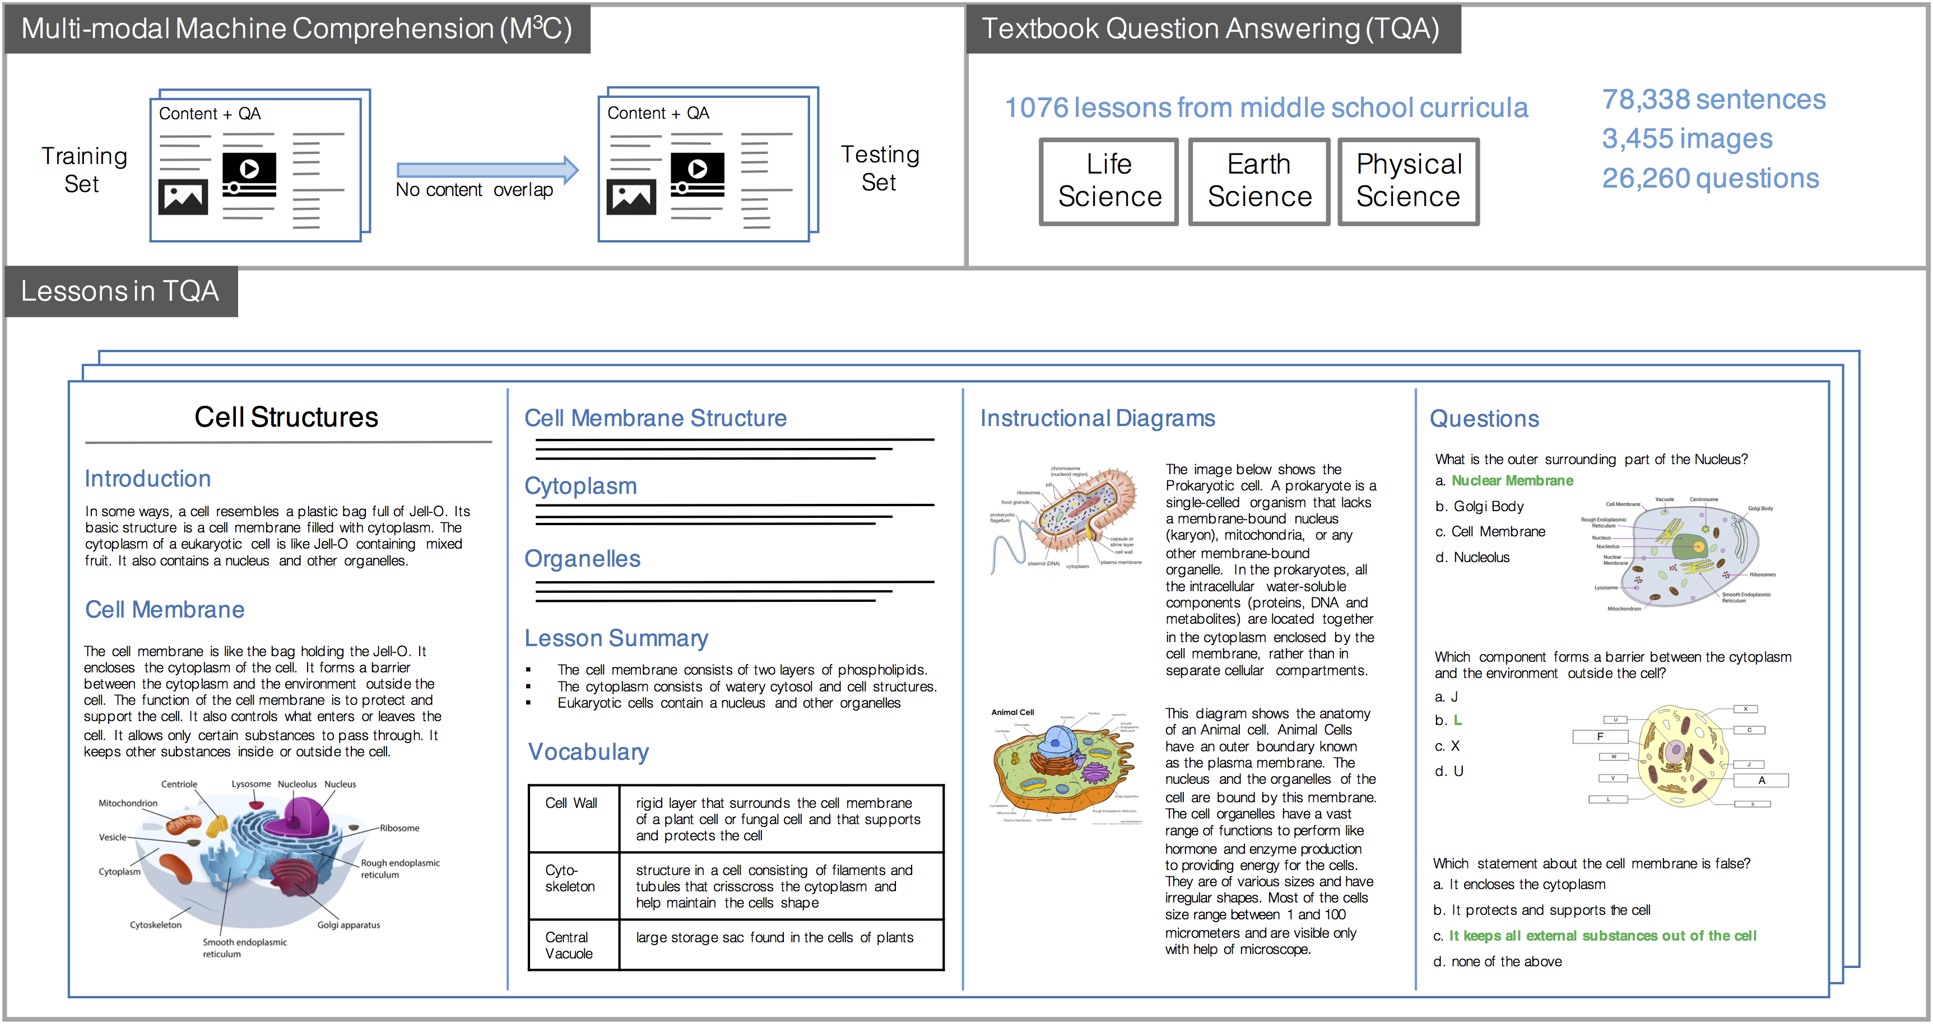

Slide 3
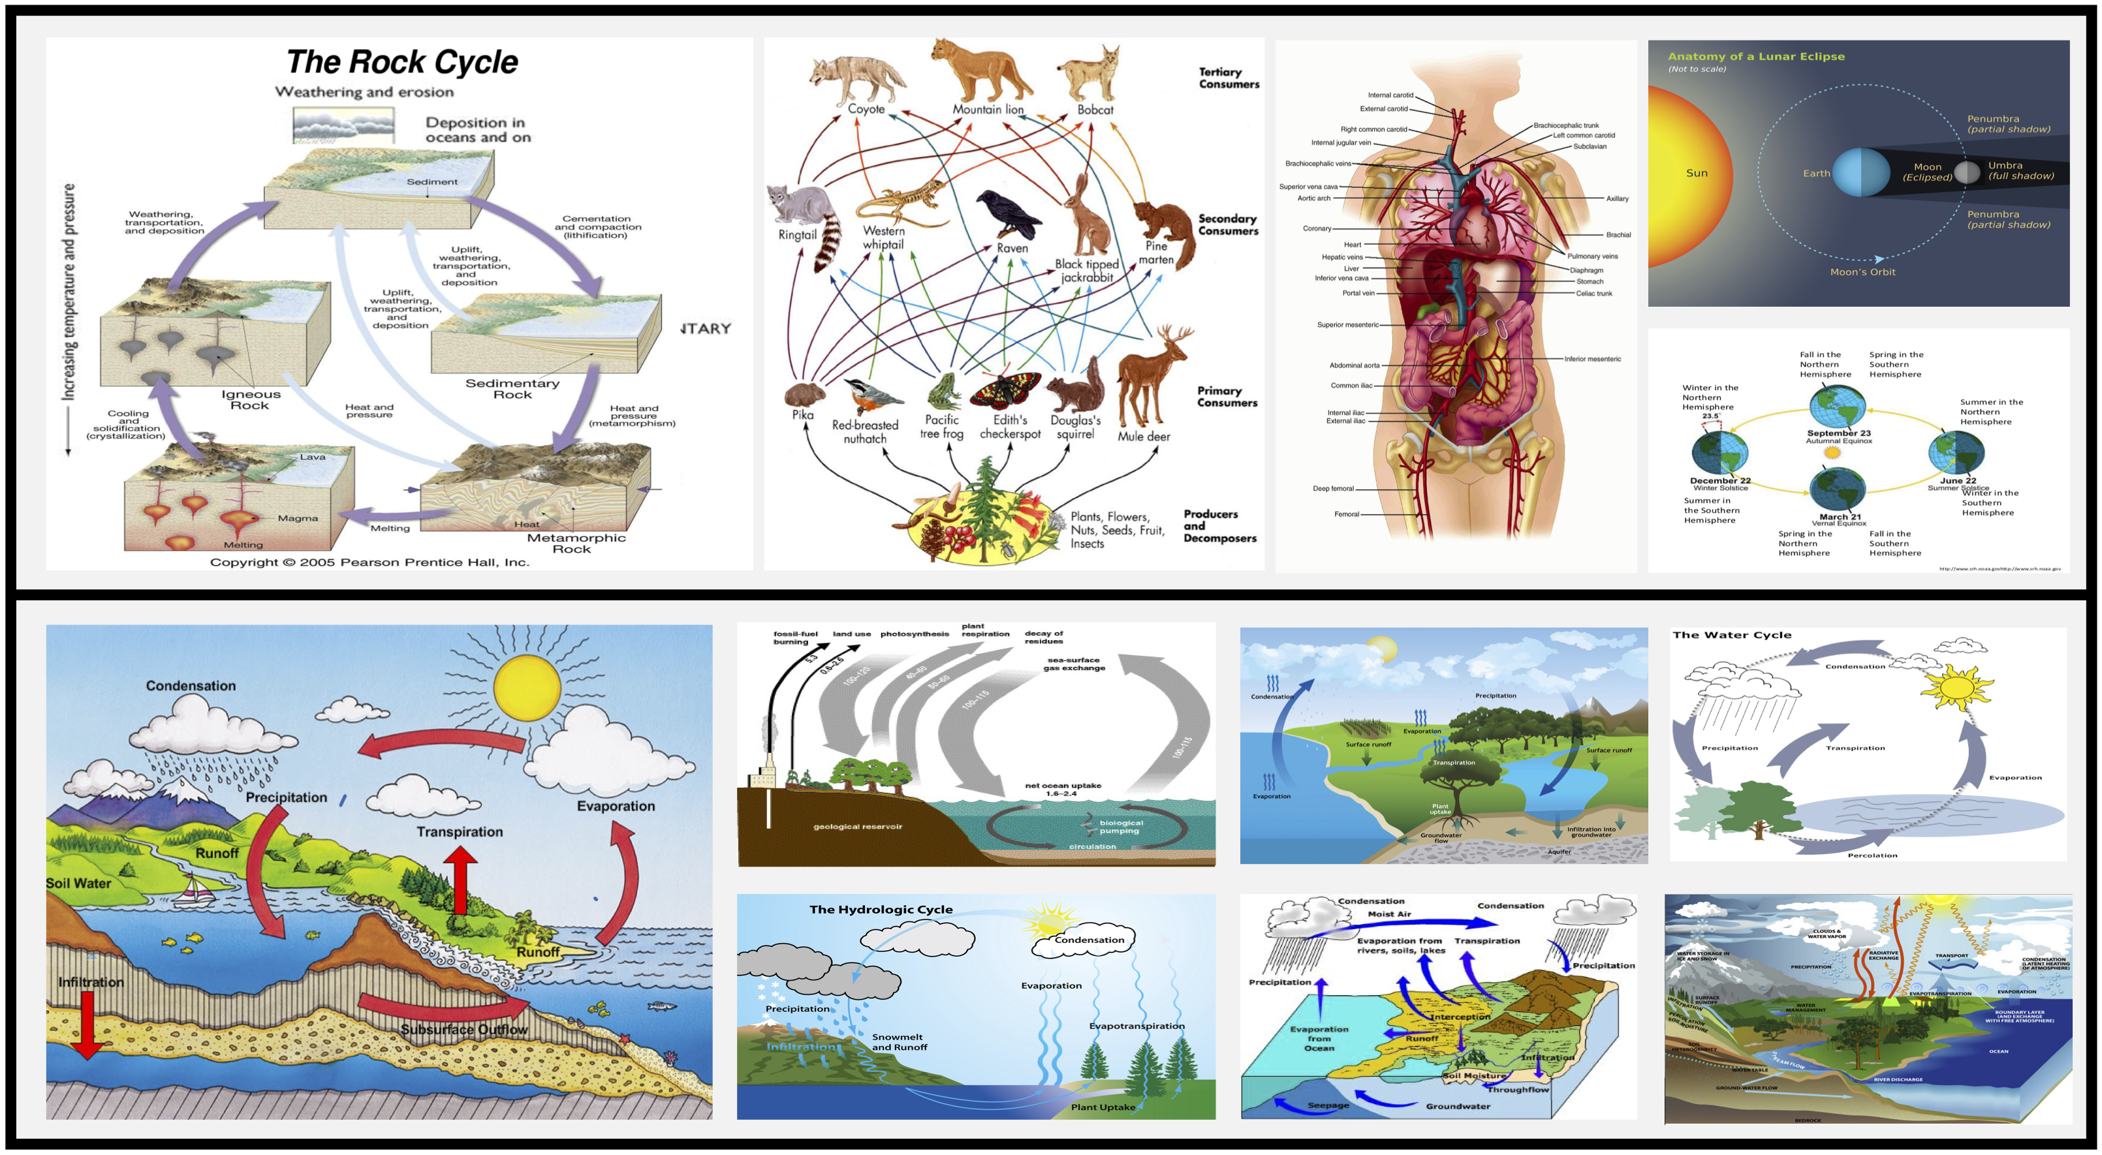

Slide 4
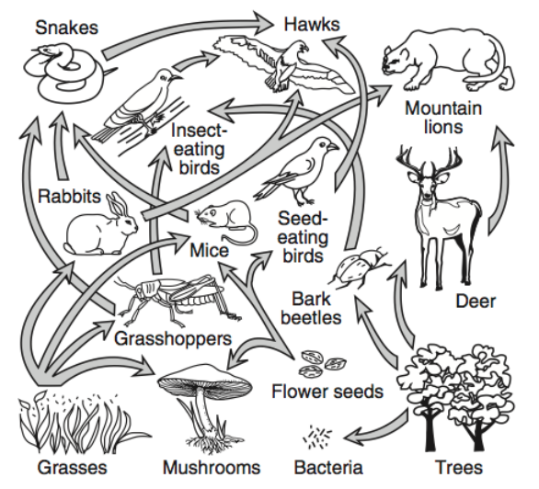
According to the given food chain, what is the number of organisms that eat deer? (A) 3 (B) 2 (C) 4 (D) 1
Which organism is both predator and prey? (A) Bark Beetles (B) Insect-eating birds (C) Deer (D) Hawks
Based on the given food web, what would happen if there were no insect-eating birds? (A) The grasshopper population would increase. (B) The grasshopper population would decrease. (C) There would be no change in grasshopper number.

Slide 5
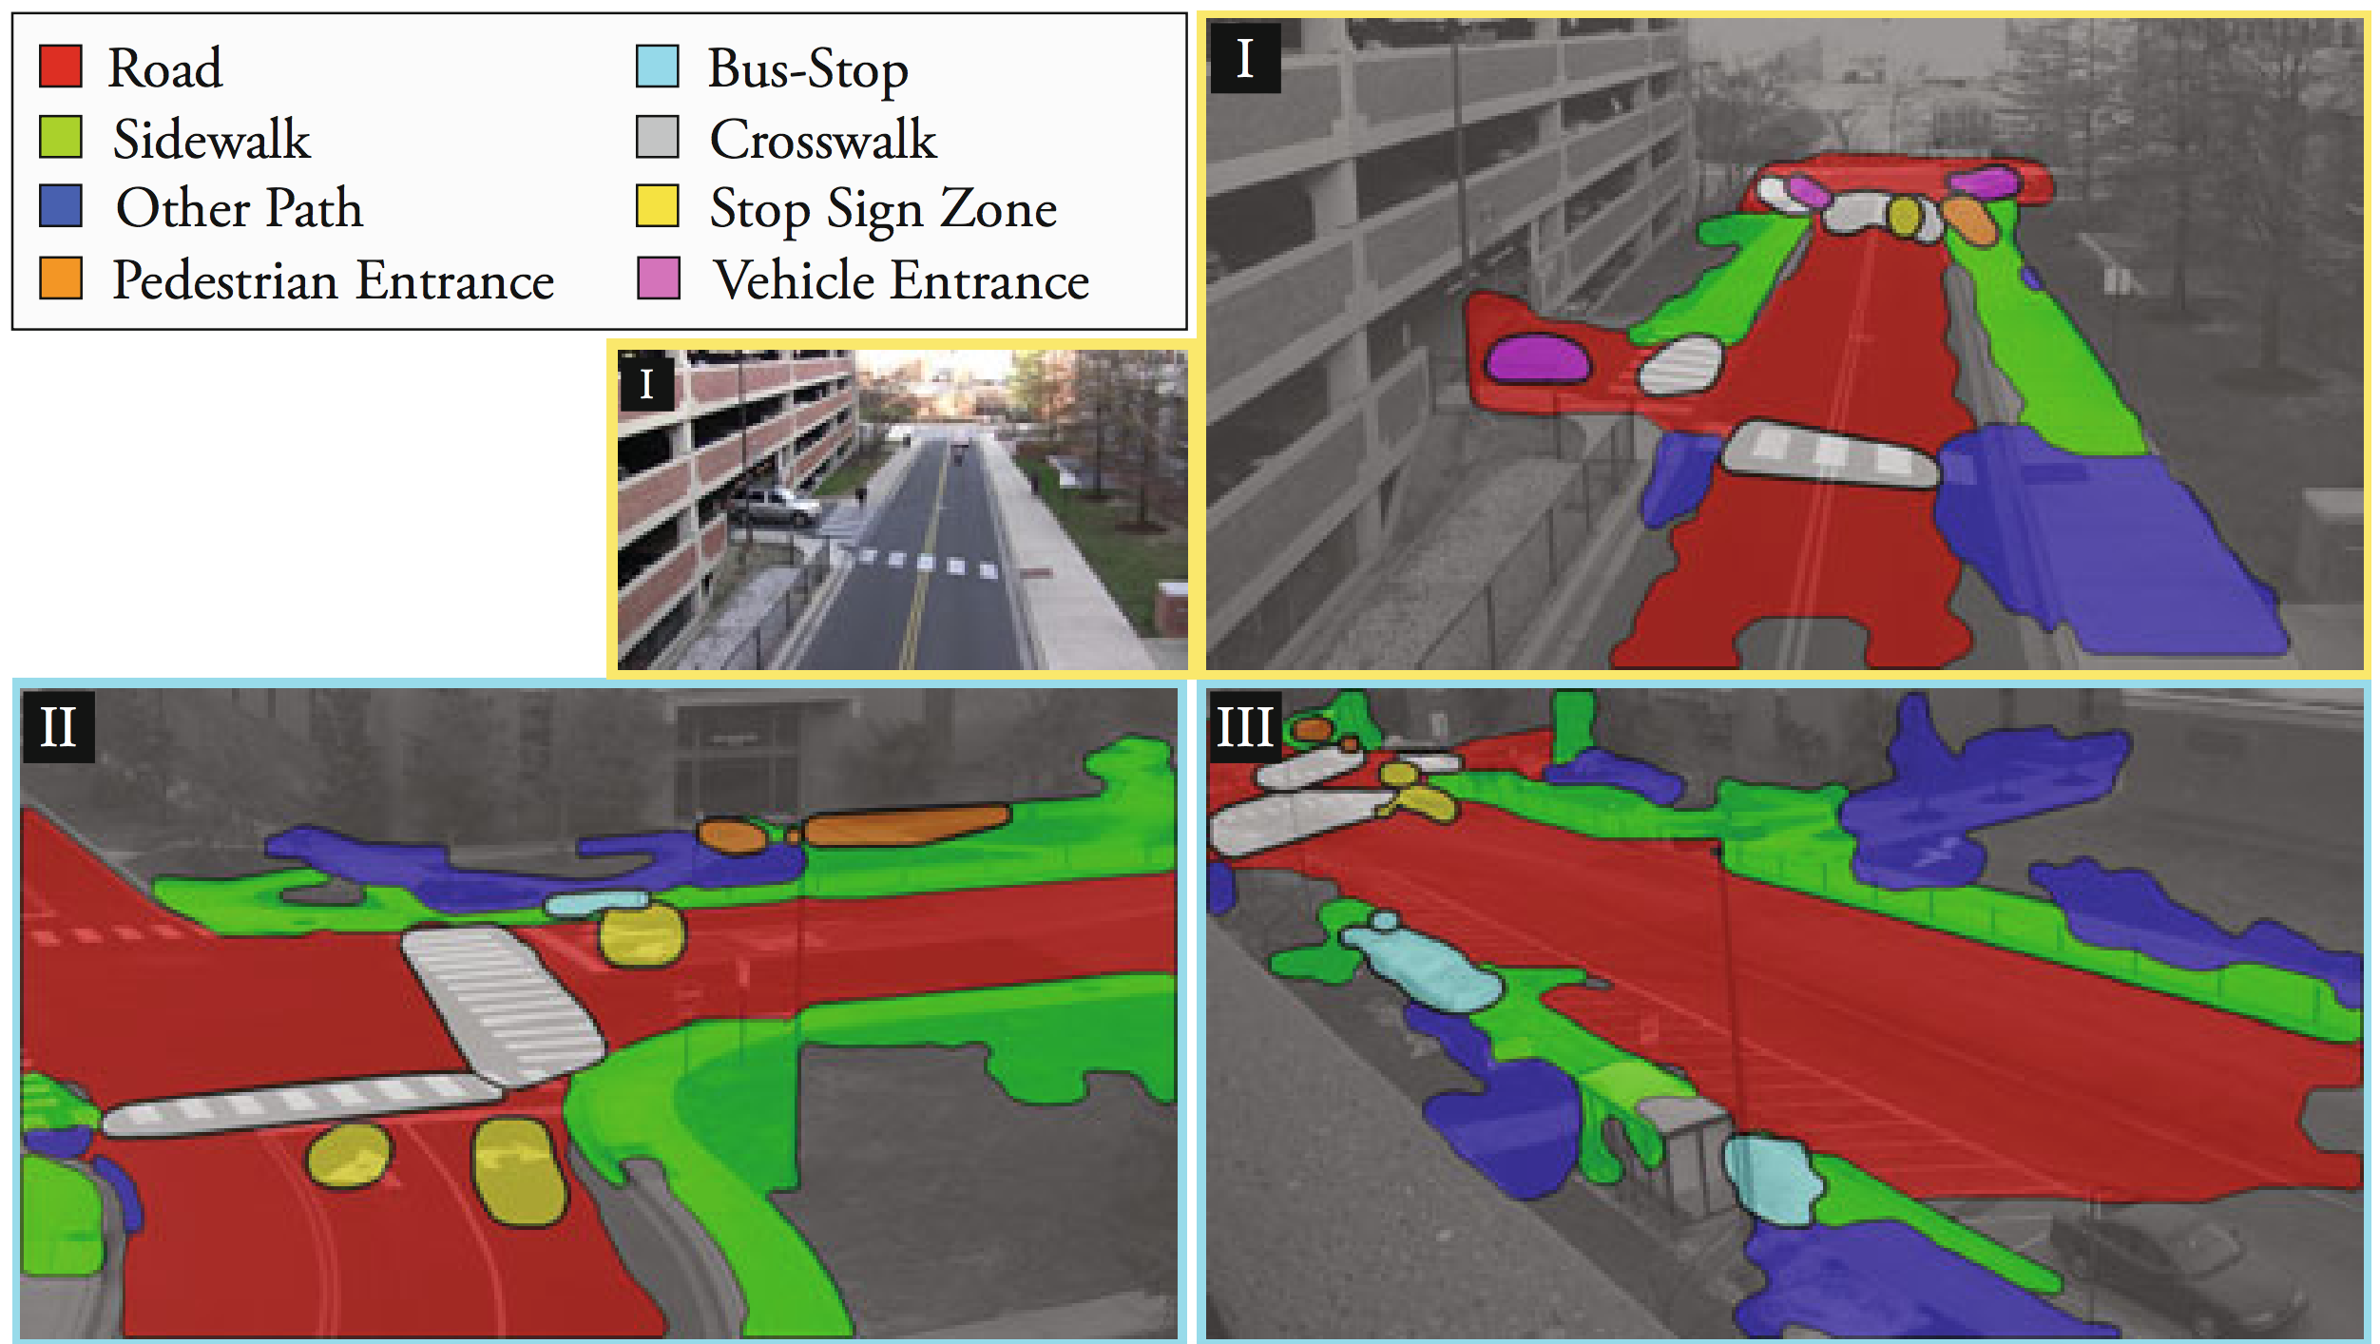

Slide 7
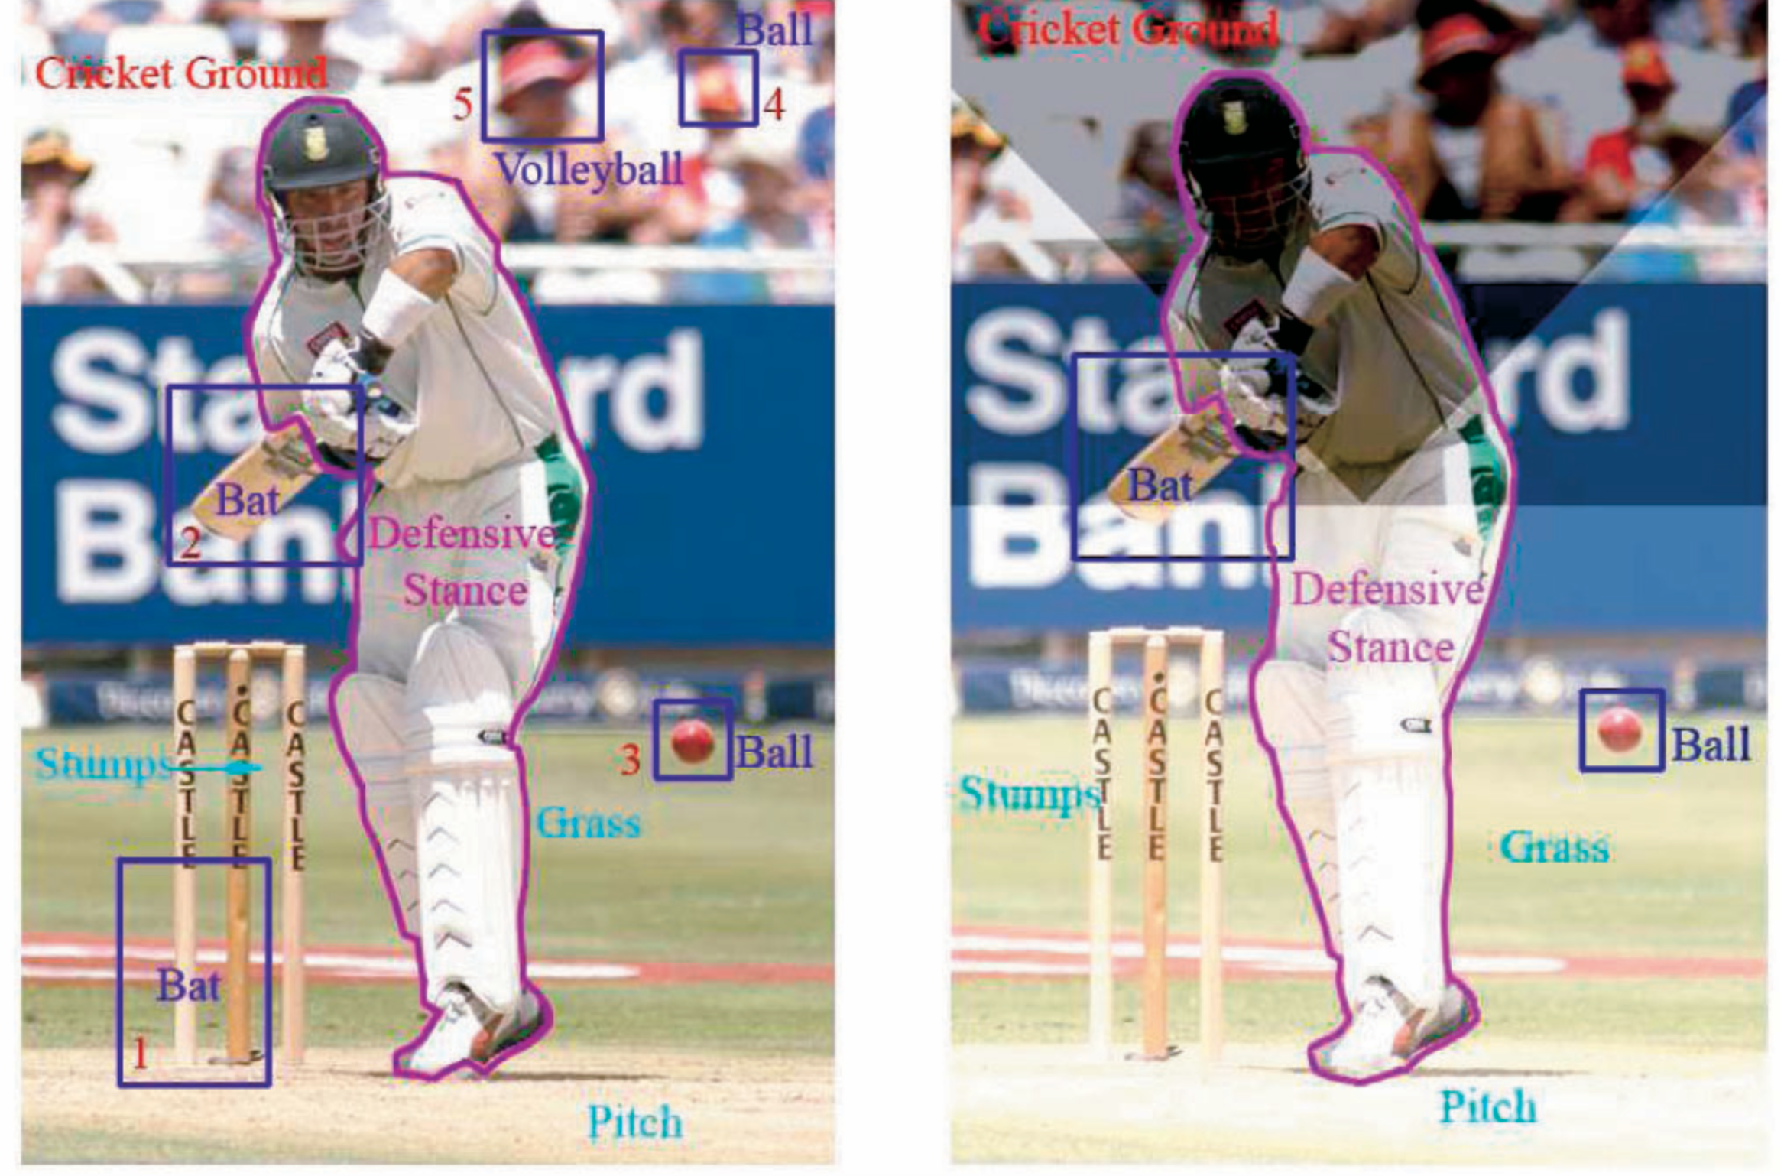

Slide 8
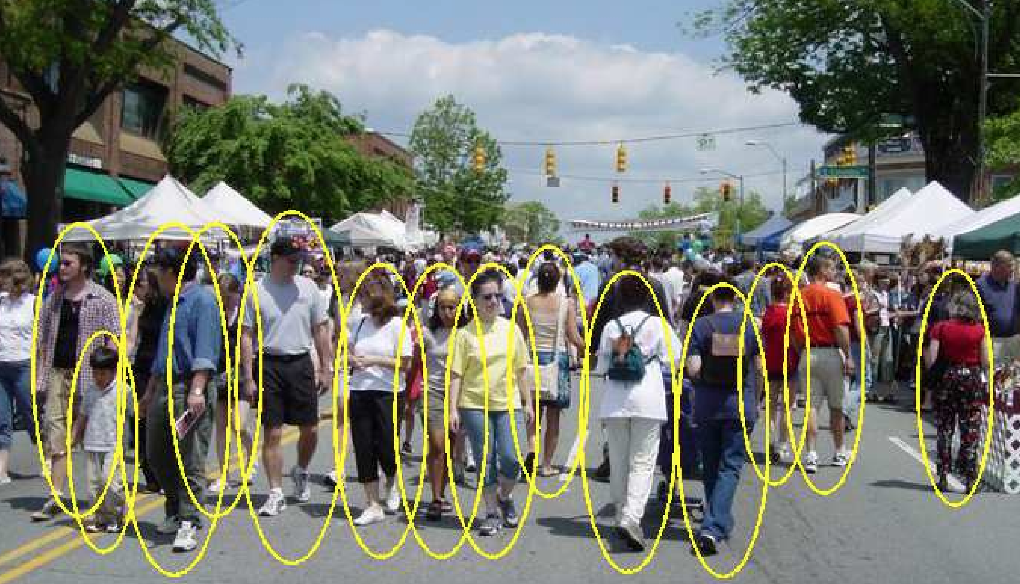

Slide 9
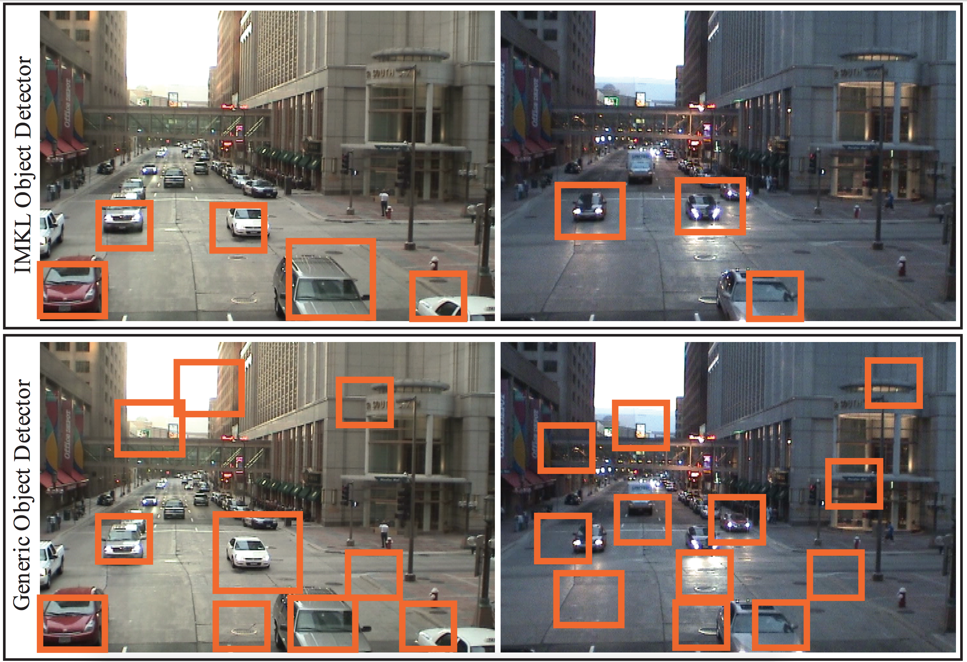

Slide 10
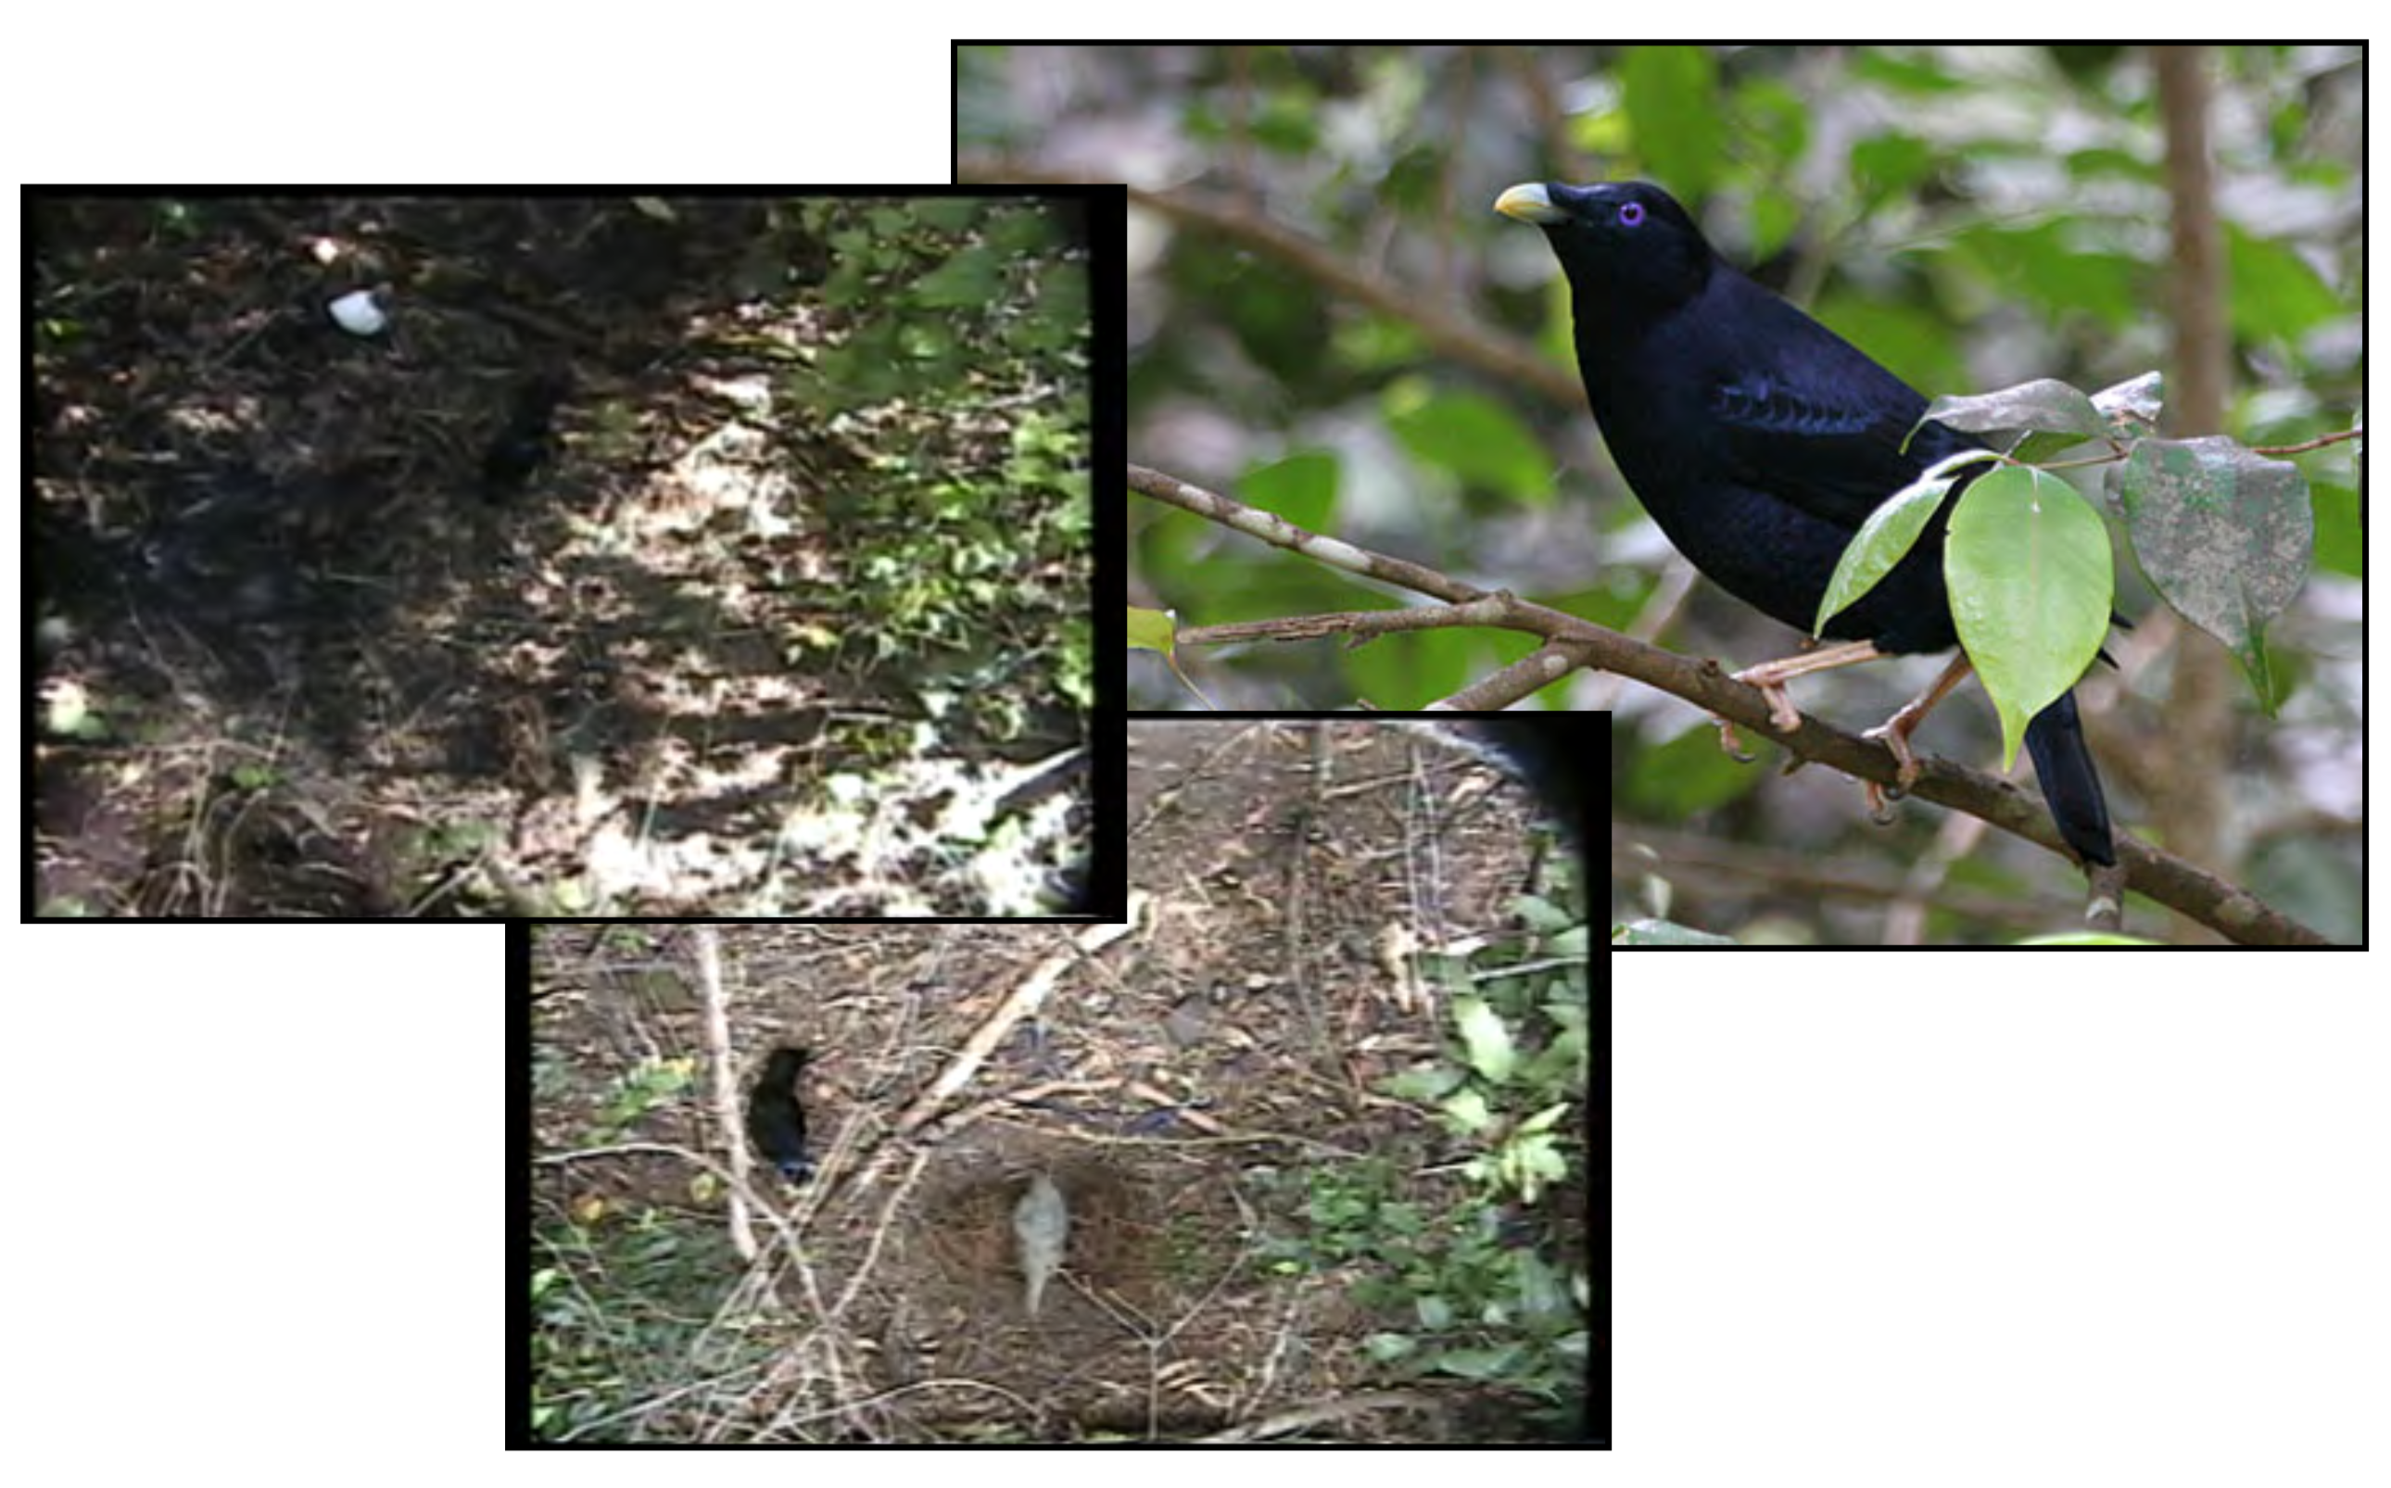

Slide 11
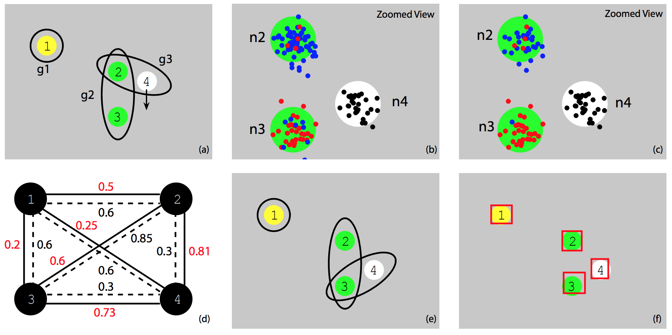

Slide 12
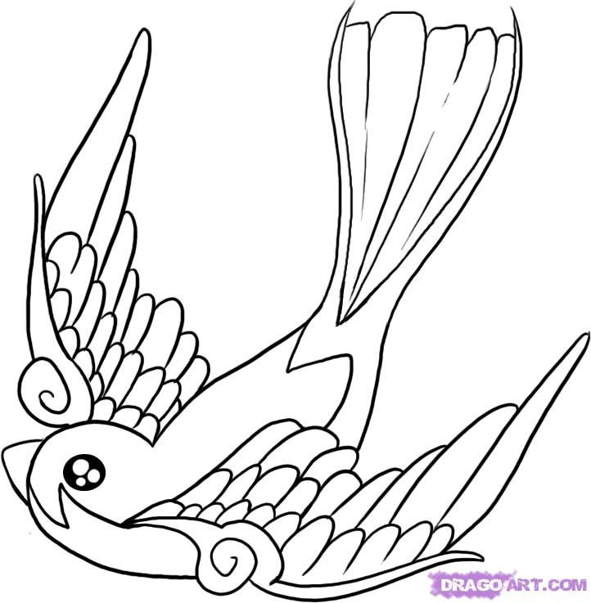
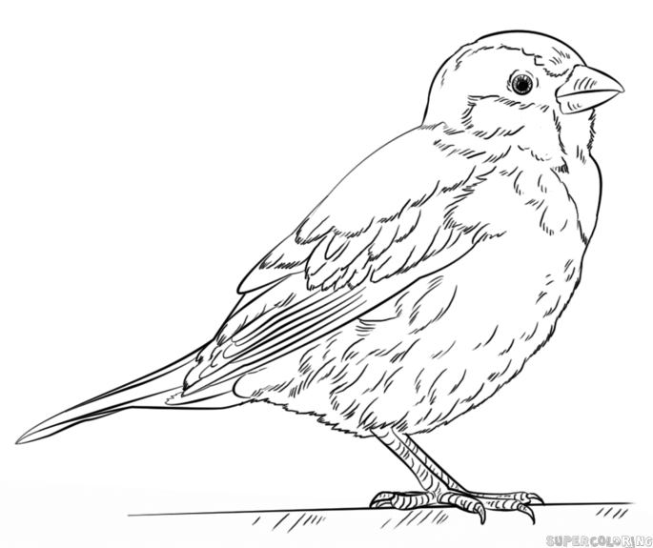
tail
rear
lear
mane
head
forehead
wing
reye
leye
SOURCE IMAGE
belly
claw
neck
nose
leg
torso
crown
back
muzzle
neck
rfleg
lfleg
leg
eye
beak
SSMN transfers labels
Diagram-to-Diagram
Image-to-Image
Image-to-Diagram
crown
beak
mane
eye
forehead
back
rear
lear
neck
muzzle
torso
head
TARGET IMAGE
wing
reye
leye
neck
nose
tail
belly
leg
leg
rfleg
lfleg
claw

Slide 13
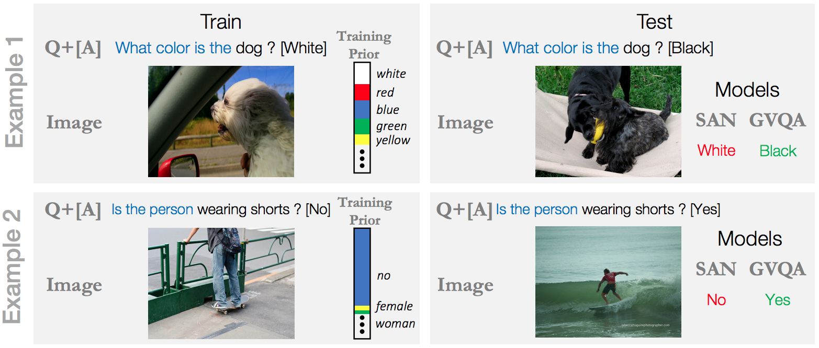

Slide 14
